Slide 1
The influence of teaching styles on the scores of a diverse group of student
Jerry Chen, Aniruddha Prasad

Slide 2
Motivation
We are both students from very different ethnic and socioeconomic backgrounds
Both come from different two very different places each with their own style of teaching
Students deserve quality education regardless of who they are or where they are from
Notes:
Ani

Slide 3
Our Objectives
Analyze the 8th grade test score dataset and recommend a teaching method (standards-based or traditional)
Find the best model for predicting scores and teachers
Scores: use teacher, socioeconomic, gender, and ethnic background
Teacher: use scores, socioeconomic, gender, and ethnic background
Tune the model for higher accuracy
Develop a “master” model with the highest predictibility
Finally see if our hypotheses were true
Notes:
Jerry
- The objective is to analyze and predict the 8th-grade test scores, and recommend a specific teaching method – standards-based or traditional.
- Use teacher, socioeconomic, gender, and ethnic background to predict the score.
- Use score, socioeconomic, gender, and ethnic background to predict the teacher for
verification.
- Analyze multiple combinations between the provided variables and analyze the trends.
- Use multiple models to develop a “master” model with the highest predictability.
- Utilize and learn the CNN and ANN process.

Slide 4
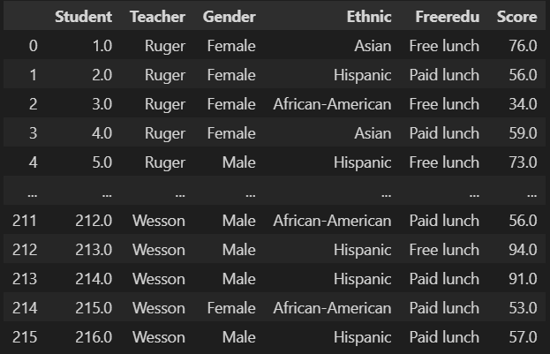
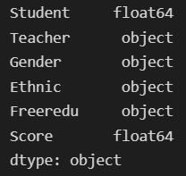
The Dataset
“Student’s Math Score for Different Teaching Styles”
215 observations
Factors:
Teachers
Ruger: Standard-based learning
Wesson: Traditional learning
Gender
Ethnicity
Free reduced lunch
Score
Structure type:
Float64: student, score
Object: teacher, gender, ethnic, freeredu
Target variables:
Score & Teacher
Notes:
Ani
For this project, we will be using the “Student’s Math Score for Different Teaching Styles” dataset from Kaggle.com. This breaks down a student’s math score, their ethnicity, socioeconomic status and the teacher that they are being taught by. There are three teachers in this dataset: Ms. Ruger, a young African-American women who is certified to teach science and math, Ms. Smith, a Caucasian lady in her 40s who is certified to teach Spanish and math and Ms. Wesson, an older Caucasian lady who has been teaching PE for 24 years but has been assigned to teach math for the last 3 years.
Each teacher is allowed to choose their own textbook and teaching styles. Ruger and Smith follow a teaching method that can be defined as the standards-based method. Under this method, the teacher is there to facilitate the learning in a constructivist environment so that students can develop, explore, conjecture and test their conjectures within the confines of the standard. The teacher believes there is research that a majority of children learn more and deeper mathematics and are better problem solvers when in the standards-based classroom.
Wesson follows a teaching method that can be defined as the traditional method. Under this method, the teacher adheres to a top-down approach in which knowledge originates from the teacher and is disseminated to the students. Traditional teachers tend to thrive on structure and order, resulting in calm learning environments. The teacher believes there is research that indicates certain behavioral issues are minimized in a traditional classroom resulting in effective, direct instruction.

Slide 5
Some Hypotheses
Expect higher performance with the standard-based method
Expect higher performance with better socioeconomic status.
Expect lower performance under Wesson with students who are underprivileged and not Caucasian
Expect lower performance from female students with a worse socioeconomic status compared to male students.
Notes:
Jerry
- Higher performance with the standard-based method and students with a better socioeconomic status.
- Lower performance under the teacher Wesson, with students who are underprivileged and not Caucasian.
- Lower performance from female students with a worse socioeconomic status compared to the male students.

Slide 6
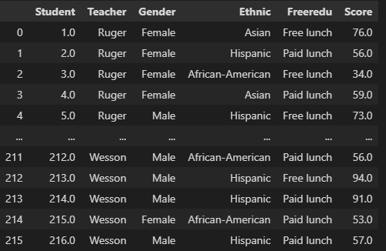
Methods
Preprocessed raw data into individual classes for easier analysis. One-hot encoding was not used.
Regression Model accuracy
KNN - 27.20%
Multivariate Regression - 58.36%
ANN
Classification Models accuracy - Some comments on this
KNN
SVC
Random Forest Classifier
Notes:
Ani
- The raw data was first preprocessed so strings such as teacher names are converted to binaries, similar to IDs, and these data can be processed more easily.
- Three regression models and three classification models were tested and the accuracies were compared to check which model can predict most accurately.
- For certain models, we performed grid searches to find the best hyperparameters and increase the model’s accuracy.
- Out of all methods, the multivariate regression model seems to be the most accurate, with an accuracy of 58%.

Slide 7
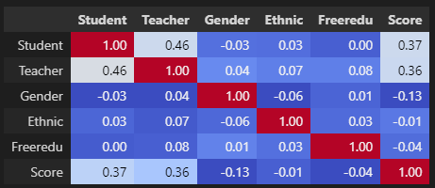
Results & Discussion
Correlation matrix shows little correlation among variables -> low accuracy from our various models.
Closer to 1 = higher correlation.
Score and Teacher variables show the highest correlation, but still low.
Notes:
Jerry
- correlation matrix shows low correlation between each variable. The closer it is to 1, the higher the correlation. Among all variables, the Score and Teacher variables show the highest correlation, but it is still fairly low. In summary, the correlation matrix explains the low accuracy results from our various models.

Slide 8
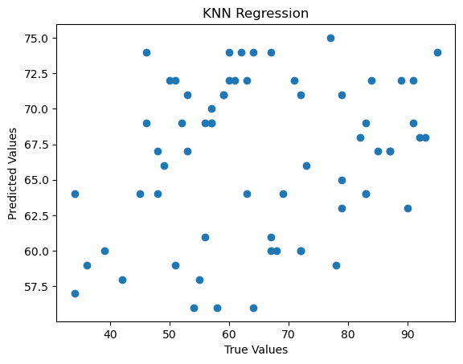
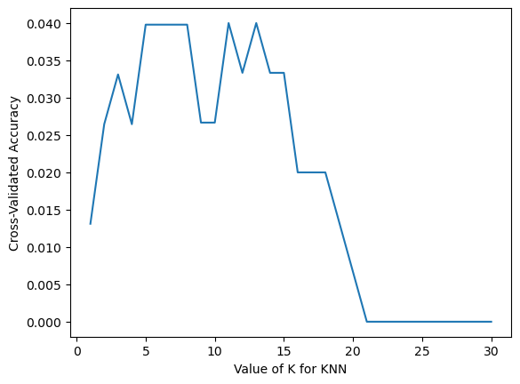
Failure of KNN on this Dataset
Knn regression had abysmal performance with poor fit and poor prediction capabilities. (image on the left)
A grid search (image on the right) revealed absolutely low scores for the KNN regressor hence why it was scrapped in favor of polynomial regression.

Slide 9
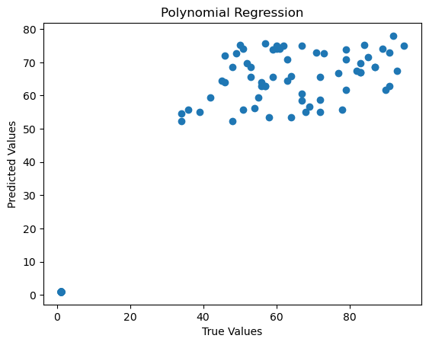
Performance of polynomial regressor
Polynomial regressor had the highest accuracy on this dataset that had low correlation.
Figure on the left shows this prediction capability. Displays higher accuracy and better prediction on the test set.

Slide 10
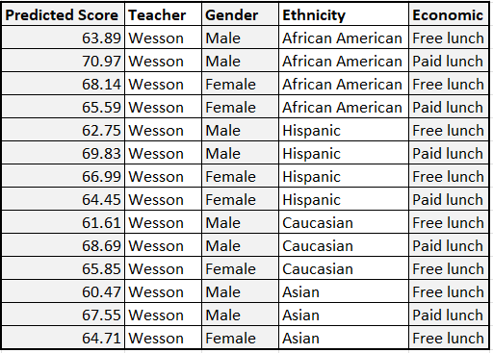
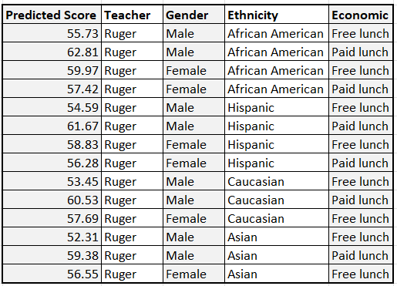
Results & Discussion
Multivariate Regression had the highest accuracy -> chosen to predict score.
Wesson has a higher average. However, we are still improving the accuracy of our models.
No correlation between gender, ethnicity, and socioeconomics.
Notes:
Jerry
- Multivariate regression had the highest accuracy among the models we tested, showing an accuracy of nearly 60%. Because of this, we chose the multivariate regression to predict the teacher.
-

